Slide 1
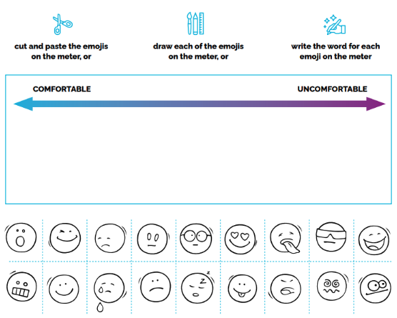
MY MOOD METER
You can complete this activity in many ways. Choose the one that works for you!
Look at each emoji and decide what feeling it represents for you.
Think about how comfortable/ uncomfortable you are when experiencing this feeling. Put the emoji/ feeling in the place it belongs on the meter for you. This is not a complete list of emotions - feel free to be creative and add emojis or feelings of your choice to the meter.

