Slide 1
8.2 Minds On

Slide 2
Sometimes I feel stressed.
Agree or Disagree?
STRONGLY AGREE
STRONGLY DISAGREE

Slide 3
Sometimes I feel stressed.
We all experience stress at times.
It is part of learning and growing.

Slide 4
Stress is bad. We should avoid or get rid of it. Agree or Disagree?
STRONGLY AGREE
STRONGLY DISAGREE

Slide 5
Stress is bad. We should avoid or get rid of it.
Not necessarily!
Stress can be positive and even helpful—like when we deal with a situation and handling it makes us feel we are capable, learning, and growing.
A certain amount of stress also helps motivate us to develop positive ways of coping and to solve problems.
It can help us to perform our best and shows something is important to us.

Slide 6
Stress is bad. We should avoid or get rid of it.
While stress can be uncomfortable, it’s really about how much stress we are experiencing.
Too little, and we feel bored and unmotivated.
Too much, and we feel overwhelmed and exhausted.
But a healthy amount of stress can help us be creative, motivated, and focused.

Slide 7
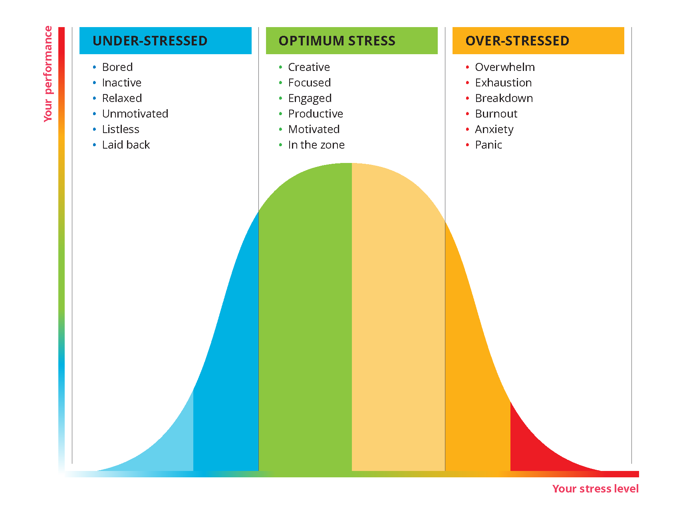
Stress Performance Curve
The key is to keep stress in a zone that works for us. Today we’re going to learn strategies that can help.

Slide 8
credits

